Slide 1

Understanding AI Agents
A Guide for HSBC Colleagues
INTERNAL TRAINING SERIES | 2026
Notes:
Hello everyone, and welcome. Today, we're going to explore an exciting topic that's reshaping the future of work: AI Agents. In this session, we'll break down what AI Agents are, how they function, and why they are relevant to us here at HSBC. Let's dive in.

Slide 2

Agenda
What is an Agent?
The Core Components
LangGraph
01
02
03
Definition and core capabilities of AI Agents in modern systems.
Breaking down the Brain, Memory, and Tools that power intelligent agents.
Building Stateful, Multi-Step Agent Flows.
Agent vs. Workflow
Design Principles
Summary & Q&A
04
05
06
Key differences and practical applications compared to traditional automation.
Solving complex problems in the simplest, most efficient way possible.
Recap of key takeaways and an open discussion session for questions.
Notes:
Here's a roadmap of our discussion today. We'll start with a clear definition of what an AI Agent is. Then, we'll dissect its three core components: the Brain, Memory, and Tools. After that, we'll talk about the philosophy behind designing effective Agents. We'll also clarify the key differences between Agents and traditional automated workflows. Finally, we'll wrap up with a summary and open the floor for questions.

Slide 3



What is an AI agent?
An AI agent is a software-based ‘actor’ (entity) that uses an AI engine to take action. It can distinguish its environment, process data, and take actions on its own to achieve specific or singular goal. AI agents operate independently and can interact with users, systems, or other agents.
Brain: The Thinking Core
Memory: The Learning System
Tools: The Action Interface
POWERED BY LLMs
SHORT-TERM CONTEXT
EXTERNAL INTEGRATION
Driven by advanced models like GPT-4 and Claude, forming the foundation of intelligence.
Maintains awareness of the current conversation thread, ensuring coherent dialogue flow.
Connects to databases, APIs, and real-world systems (via MCP or similar protocols).
CORE INTELLIGENCE
LONG-TERM RECALL
EXECUTION CAPABILITY
Handles complex reasoning, multi-step planning, and the deep understanding of user intent.
Stores, summarizes, and retrieves past interactions to deliver personalized and contextualized service.
Encapsulates specific skills and workflows to turn decisions into tangible, effective actions.
Notes:
To understand AI Agents, we need to look at their three fundamental building blocks. First, the Brain, which is the large language model that does the thinking. Second, Memory, which allows the agent to learn from past experiences. And third, Tools, which are the agent's hands and feet, letting it interact with the outside world. Together, these three components create a system that can understand, learn, and act.

Slide 4



Brain (LLM）
Reasoning
Understanding complex instructions and figuring out the optimal strategy to achieve a given goal.
Planning
Decomposing large, complex tasks into smaller, actionable, and manageable sequential steps.
Reflection
Learn from execution results, correct errors, and optimize strategies to achieve self-correction and continuous evolution.
Without a powerful "Brain", an Agent cannot make sense of the world or take meaningful action.
Notes:
The first core component is the "Brain." This is essentially the large language model, the AI engine that drives everything. It's what allows the Agent to understand, reason, and plan. Whether it's breaking down a complex request or generating human-like responses, the brain is the central processing unit that gives the Agent its intelligence.

Slide 5

🤖 Memory: Short-term vs. Long-term
Memory stores context, historical interactions, and business data. It is the cornerstone for enabling continuous learning and personalized responses in AI agents.
Architecture Data Flow
Current Conversation
Short-term Memory (Context Window)
Short-term Memory
Resides within the LLM's context window, ensuring coherent understanding and response generation for the current conversation turn.
Summarization & Compression
Long-term Memory (Persistent Storage)
Long-term Memory
An independent, persistent storage system. It summarizes and compresses short-term context to retain crucial information over extended periods.
Recall for Context
Notes:
First up is Memory. Think of it as the agent's ability to remember. Short-term memory is like your working memory, keeping track of the current chat. Long-term memory is like a filing cabinet, where important information from past interactions is stored for later use. This diagram shows how information flows between these two systems, allowing the agent to learn and provide personalized service.

Slide 6

Agentic RAG: The Intelligent Upgrade
CORE CONCEPT
Agentic RAG Flow
Agentic RAG is the "intelligent upgrade" of traditional RAG. It dynamically optimizes user queries, verifies retrieved information for accuracy, and autonomously decides whether to continue searching or synthesize an answer.
User Query
Agent (LLM)
Optimize Query?
Info Sufficient?
PRACTICAL EXAMPLE
Faced with multiple heterogeneous sources (Database, Knowledge Base, Web), the Agent evaluates the user's intent and automatically selects the most appropriate source to query, rather than a brute-force search of all.
Query Sources (DB, KB, Web)
Generate Answer
Notes:
Next is Agentic RAG. Traditional RAG is like a simple search engine. Agentic RAG is smarter. It doesn't just search; it thinks about how to search. As this diagram shows, the agent first optimizes the user's query, then searches the right sources, checks if the information is good enough, and if not, it tries again. This makes it much more effective for finding the right answer.

Slide 7


MCP Protocol: The Universal Connector
WHAT IS MCP?
AI App A
Tool 1
Model Communication Protocol
MCP Server
(Universal Connector)
A unified standard that acts as a central "translator" between AI applications and external resources. It eliminates the need for custom integrations, enabling seamless and standardized communication.
AI App B
Database
Standardization
One protocol for all AI integrations
AI App C
API
Flexibility
Easily plug in new apps or tools
Notes:
Now, let's talk about the MCP Protocol. Imagine it as a universal plug adapter for AI. Instead of every AI app needing a custom connection to every tool, they all connect to an MCP server. This server acts as a hub, translating requests and responses, making it easy to plug in new applications or tools. It's all about standardization and flexibility.

Slide 8

🤖 Skills: From Generalist to Expert
Skills are the key to upgrading a model from "pure text generation" to "task execution". Each Skill encapsulates domain knowledge, workflows, and tools for a specific business task, turning a generalist into a specialist.
General-Purpose LLM
Pure text generation
No domain focus
Domain Expert Agent
+ Skill: "Customer Onboarding"
Workflow | Tools | Knowledge
Notes:
Skills are what turn a general AI model into a specialist. Think of a skill as a pre-packaged set of instructions for a specific job, like "processing a loan application." By adding this skill to a general model, it instantly knows the workflow, which tools to use, and where to find the necessary information. It's like giving a generalist AI a specialized training manual.

Slide 9


What is LangGraph?
A graph-based AI Agent orchestration framework for building stateful, multi-step, collaborative AI applications.
Core Purpose
Essence
It's an "Agent Runtime" that provides fine-grained control over the flow of complex tasks, acting as the conductor for your AI system.
A production-grade, stateful workflow engine that abstracts complex execution logic into a directed graph of Nodes (work) and Edges (flow).
"Nodes do the work, Edges decide what's next, and State remembers everything."
Notes:
So, what exactly is LangGraph? In simple terms, it's a framework for building complex AI agents. Think of it as the conductor for your AI symphony. It doesn't play the instruments (that's the LLM and tools), but it directs how they play together. Its core job is to manage the workflow, ensuring each step happens at the right time, and that all information is remembered and shared.

Slide 10



Core Component 1: State (The Memory)
The unified memory hub for the entire workflow.
DEFINITION
A strongly-typed data structure shared by all nodes in the agent workflow. It acts as the single source of truth.
Agent State (Shared Memory)
User Query Input Context
Chat History Dialogue Logs
CORE PURPOSE
Tool Results Execution Data
Task Progress Step Status
Permanently stores user input, full conversation history, task progress logs, and raw/processed tool execution results.
Nodes (Read / Write Access)
KEY ARCHITECTURAL FEATURE
Planner Node Writes Intent
Executor Node Reads Params
Memory Node Syncs Data
Supports safe, concurrent updates viaReducerfunctions, ensuring data integrity even with parallel node execution.
Notes:
The first core component is the State. You can think of it as the agent's brain's hard drive. It's a shared memory space that holds all the information needed for the task.
Every node in the graph can read from and write to this state, ensuring that critical information like conversation history or task results is never lost and is always available to the next step.

Slide 11





Core Component 2: Node (The Worker)
The smallest functional unit that performs a specific task.
DEFINITION
ARCHITECTURE DIAGRAM
A self-contained function that encapsulates a single piece of business logic or operation.
Input State
Context, Variables, Previous Results
CORE PURPOSE
Consumes the current workflow state, executes an action (API/LLM call), and returns a newly updated state object.
Node: call_llm_node
Execution Logic: Call LLM API with system/user prompt
DESIGN PRINCIPLE
Output State
Designed as "Pure Functions" – same input always yields the same output, ensuring high reusability and testability.
Enriched Data, LLM Response, Next Step Trigger
Notes:
Next is the Node. If the State is the memory, the Node is the worker.
Each node is a self-contained function that does one specific job. It could be calling the AI model, searching the web, or making a calculation.
It takes the current state as input, does its work, and returns a new state as output. This modular design makes building complex workflows much easier.

Slide 12
Core Component 3: Edge (The Navigator)
The rule that determines the next step after a node completes its execution.
▍ DEFINITION
WORKFLOW LOGIC VISUALIZATION
A logical connection between two workflow nodes that defines the transition path. It acts as the "traffic sign" for the workflow engine.
Node A Start Point
Condition?
▍ TYPE 1: NORMAL EDGE
Represents a fixed, linear sequence (e.g., A → B → C). The workflow proceeds directly to the next node without any evaluation.
NO (Loop)
YES
Node B
▍ TYPE 2: CONDITIONAL EDGE (KEY)
Dynamically chooses the next node based on the current data state. This is the fundamental mechanism for implementing loops, branches, and adaptive decision-making in AI workflows.
Conditional edges enable dynamic pathfinding & iteration
Notes:
The third component is the Edge. This is the navigator of the workflow. It defines the path the execution should take.
A normal edge is a simple, fixed path from one node to the next. But the real power comes from conditional edges. They act like decision points, allowing the workflow to branch or loop based on the current state.
This is how you build an AI that can adapt and make decisions.

Slide 13







Core Component 4: Graph (The Blueprint)
The entire workflow constructed from Nodes and Edges.
DEFINITION
The complete structural model that defines the application's logical flow, data dependencies, and execution paths.
Components
Assembly Result
State
ASSEMBLY LIFECYCLE
Node
Define State Create shared memory
Add Nodes Register worker logic
Edge
Compiled Graph Ready to Run Application
Add Edges Set flow & rules
Compile Build executable
Notes:
Finally, the Graph itself is the blueprint of your entire application. It's what you get when you assemble all the nodes and edges together. The process is straightforward: define your state, add your nodes, connect them with edges, and then compile the whole thing into a runnable application. This graph is the executable logic of your AI agent.

Slide 14


Workflow vs. Agent
WORKFLOW| Rigid & Predefined
AI AGENT| Autonomous & Dynamic
NATURE
Fixed, rule-based process with zero deviation.
NATURE
AI-native core with reasoning & self-learning.
EXECUTION
Follows a strict, pre-written script step-by-step.
EXECUTION
Proactively decomposes tasks & plans dynamically.
ARCHITECTURE: LINEAR PIPELINE
ARCHITECTURE: DYNAMIC NETWORK
Step 1
Step 2
Step 3
Step 4
Tool A
Agent
Data B
Skill C
Notes:
Finally, let's clarify the key difference between a Workflow and an Agent. A workflow is like a recipe; it's a fixed set of steps. It's reliable for repetitive tasks but can't adapt.
An Agent, as shown in the diagram on the right, is dynamic. It doesn't follow a fixed path; it assesses the situation, decides which tools and skills to use, and charts its own course. This makes it far more flexible for handling the unexpected.

Slide 15
🤖 Single-Agent Architecture
CORE CONCEPT
Single-Agent Workflow
ASingle-Agenthandles the entire task workflow independently: from understanding the task, making decisions, invoking tools, to generating the final result. This is the most fundamental and straightforward architectural form in AI systems.
Task Input
Agent
(Understand → Plan → Execute)
Key Characteristics
• Full end-to-end workflow management • Self-sufficient decision making loop • Simplest form for AI orchestration
Task Output
Notes:
Let's look at the Single-Agent Architecture. This is the most basic form. One agent does everything: it understands the task, plans how to do it, uses the necessary tools, and delivers the result. It's like having a single employee handle a project from start to finish. It's simple and effective for many tasks.

Slide 16


🤖 Multi-Agent Architecture
A Multi-Agent system mimics a high-performing human team, structured with one central orchestrator and multiple specialized executors to tackle complex, multi-faceted challenges.
Multi-Agent Team
Main Agent (Coordinator)
Main Agent (The Coordinator)
Task
Task
Task
Responsible for decomposing the main goal into sub-tasks, assigning work to the right specialists, and finally compiling all the outputs into a cohesive result.
Sub-Agent
(Research)
Sub-Agent
(Analysis)
Sub-Agent
(Reporting)
Specialized Sub-Agents
Domain experts (e.g., Research, Analysis) that execute their assigned micro-tasks independently and efficiently, then send their specific results back to the Main Agent.
Result
Result
Result
Notes:
For more complex tasks, we use a Multi-Agent Architecture. This is like a team of specialists. A main agent acts as the project manager, breaking down the big task into smaller parts and assigning them to sub-agents who are experts in their fields, like research or analysis. They work in parallel and report back to the main agent, who then compiles the final result. It's a powerful model for tackling complex challenges.

Slide 17
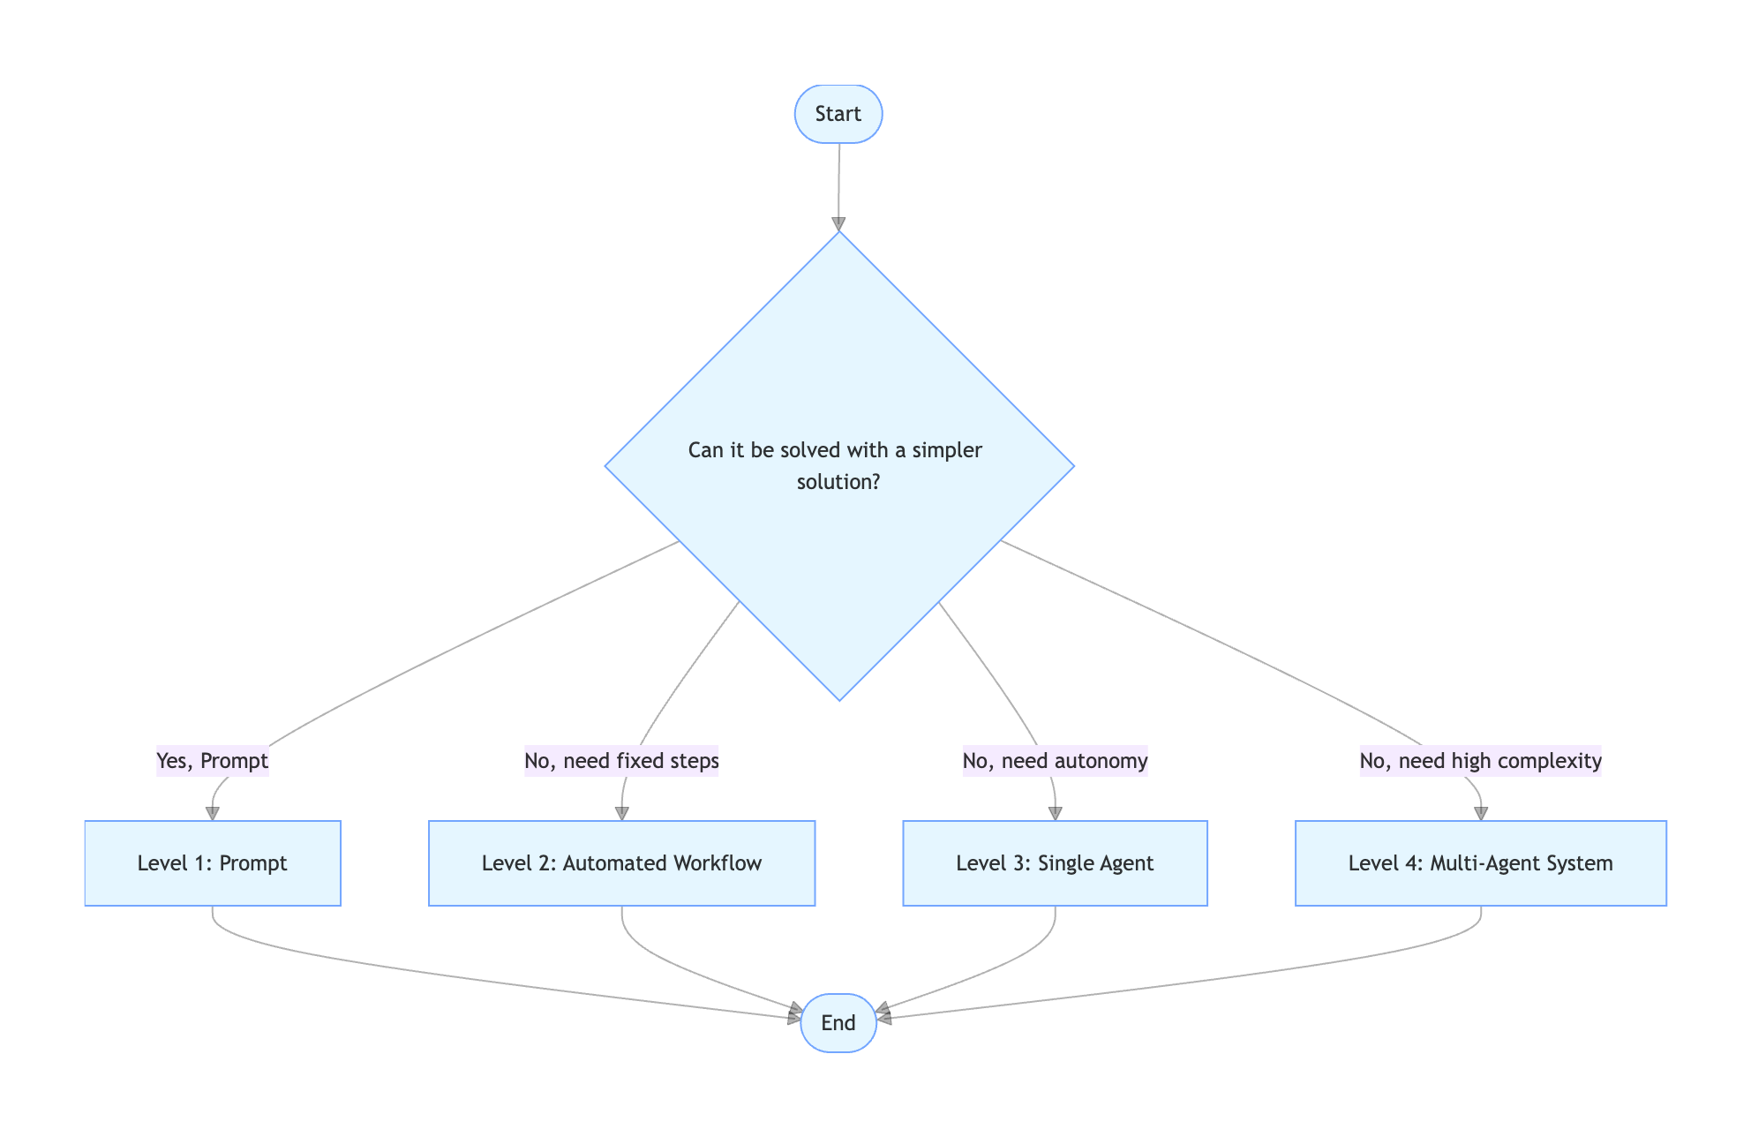




The Design Principle
Keep It Simple
1. Use a prompt if it can solve the problem
Start with a well-crafted prompt to a large language model for the most straightforward tasks.
2. Use an automated workflow for fixed steps
For tasks requiring a predictable sequence of operations, a workflow is more efficient and reliable.
3. Use a single Agent for autonomous tasks
Reserve the complexity of a full Agent for problems that demand true adaptability and independent action.
4. Multi-Agent system only for high complexity Deploy a team of agents only when no single agent can handle the complexity.
Notes:
Now, let's talk about a crucial design principle: KISS, or "Keep It Simple, Stupid." The goal isn't to use the most complex technology available, but to use the right tool for the job. We should always start with the simplest solution. Can a well-written prompt get the job done? Great. If not, can an automated workflow handle it? Only when we need true autonomy and adaptability should we reach for a full Agent, and only for the most complex tasks should we consider a multi-agent system.

Slide 18
Thank You
Q&A
LET'S DISCUSS
Notes:
That wraps up our overview of the six essential terms for understanding AI Agents. I hope this has been clear and helpful. Now, I'd be happy to answer any questions you may have. Thank you.

